Slide 1
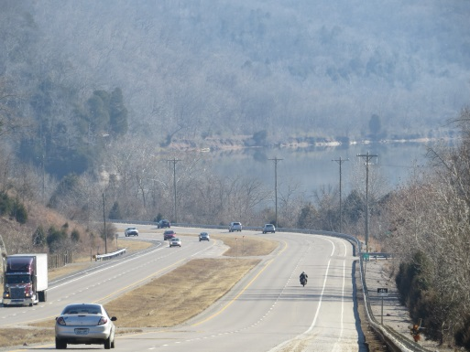
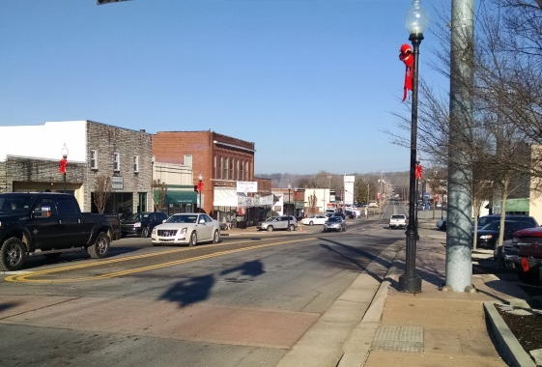
Planning for Design
Shawn Dikes, AICP
FHWA / KYTC / ACEC Partnering Conference 2015

Slide 2
Planning Stage If done well, a smooth transition into design. If not done well………..
Pearls Before Swine by Stephan Pastis

Slide 3
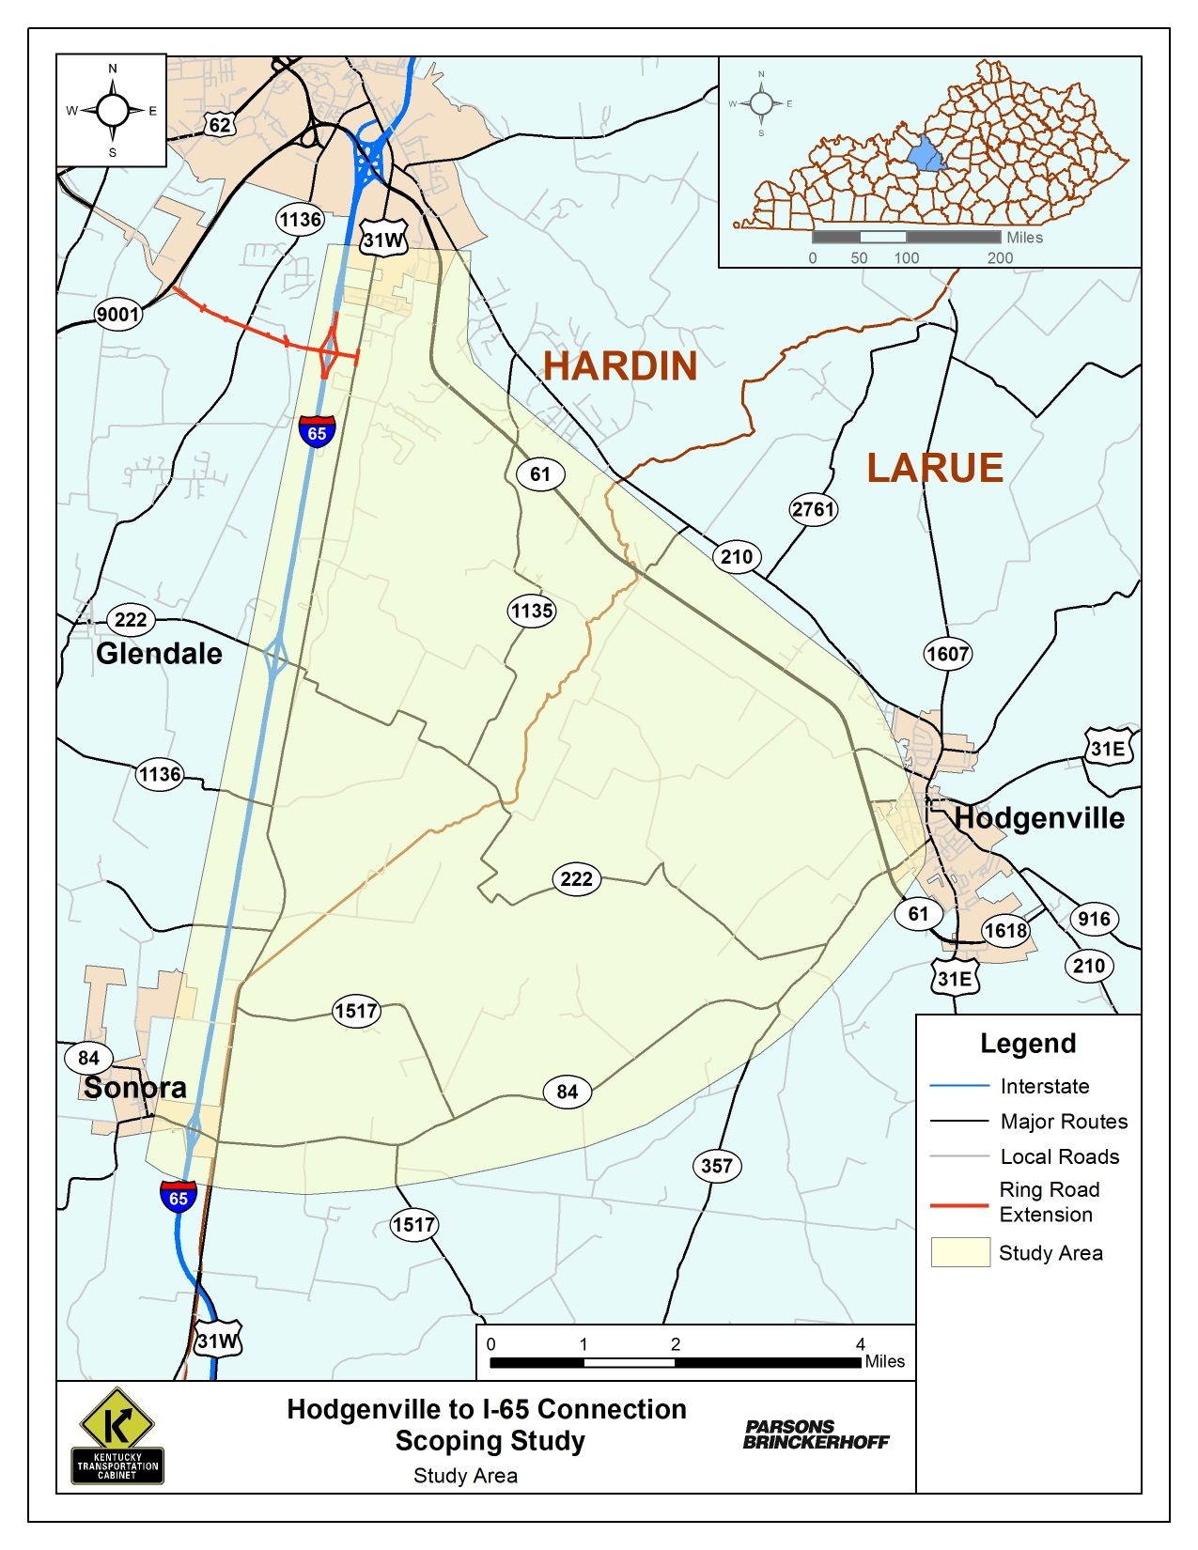
Planning Focus Areas
Manage Risks
What We Know?
What We Don’t Know?
Total Unknowns Build a project foundation for success.

Slide 4
Planning Stage
First “official” step in the continuum of project development. Sets:
Project Expectations
Local Official Expectation
Stakeholder Expectations
Budgets
Some Aspects of Design

Slide 5
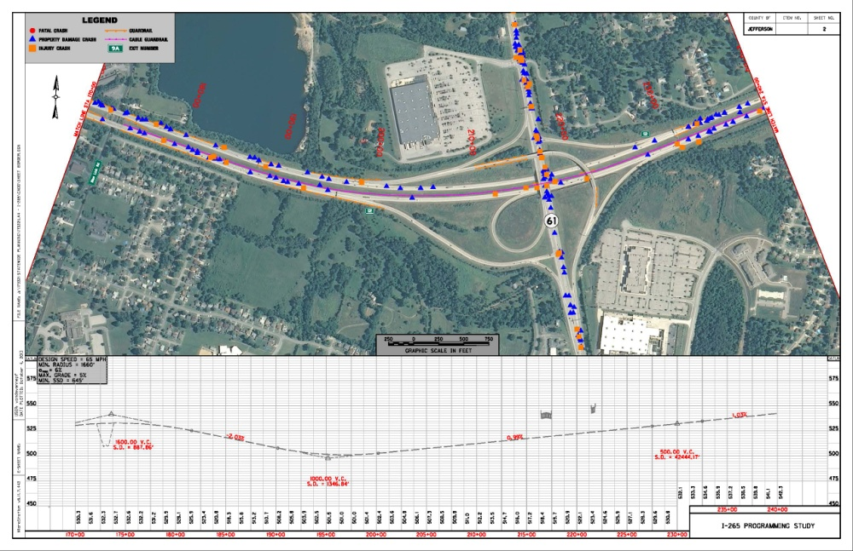
Planning Focus Areas
Purpose & Need
Local Official Involvement
Stakeholder Involvement
Environmental Analysis
Capital Costs
Traffic / TDFM
Multimodal Aspects
Operations

Slide 6
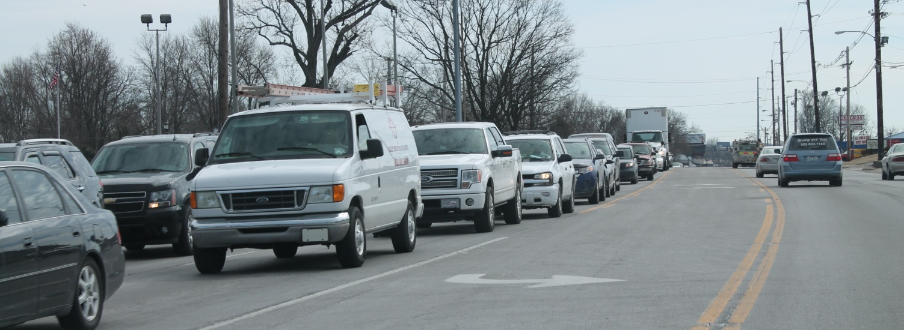
Purpose & Need
Be Realistic
Transportation Purpose is the Focus
Use KYTC’s Guidance
Develop DRAFT
Get Buy In From Others
Revise As Necessary
Needs Reinforce the Purpose
Relate Purpose & Need to Measures / Technical Analysis

Slide 7
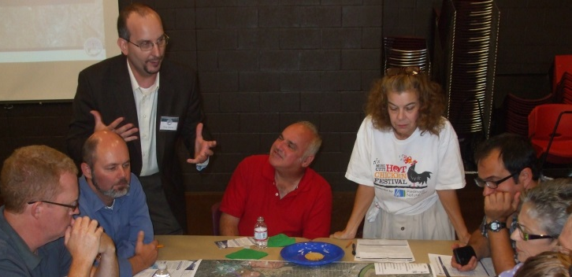
Local Official /Stakeholder Involvement
Who to Involve?
Elected Officials
Local / State Agency Technical Staff
Resource Agencies
Public
When to Involve Them?
Scoping Stage(s)
Technical Work / Reviews
Decision Making

Slide 8
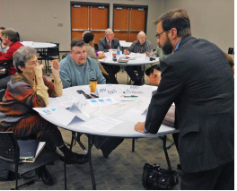
Stakeholder Involvement
How to Involve?
One on One Meetings / Interviews
Group Meetings
Surveys
On-line
Paper
Open House Meetings
Social Media
One Size Doesn’t Fit All

Slide 9
Stakeholder Involvement
Offer Opportunities for Meaningful Discussion and Involvement
Build & Shape Project Decisions
Avoid Conflicts in the Future
Listen to Other Points of View
Get Better Projects

Slide 10
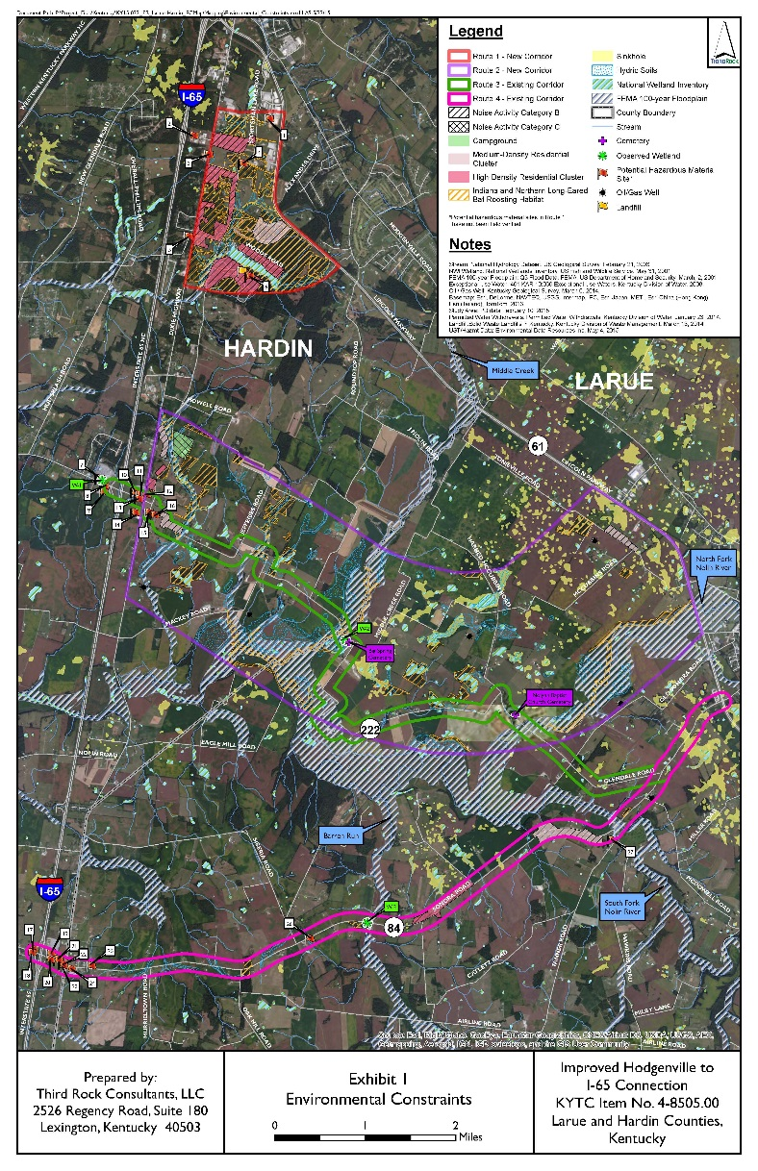
Environmental Analysis
What to Include?
Environmental Overview(s)
Constraints Map(s)
Narrative / Documentation
Scope
Natural
Cultural / Historic
Human / Socio Economic
Geo Tech

Slide 11
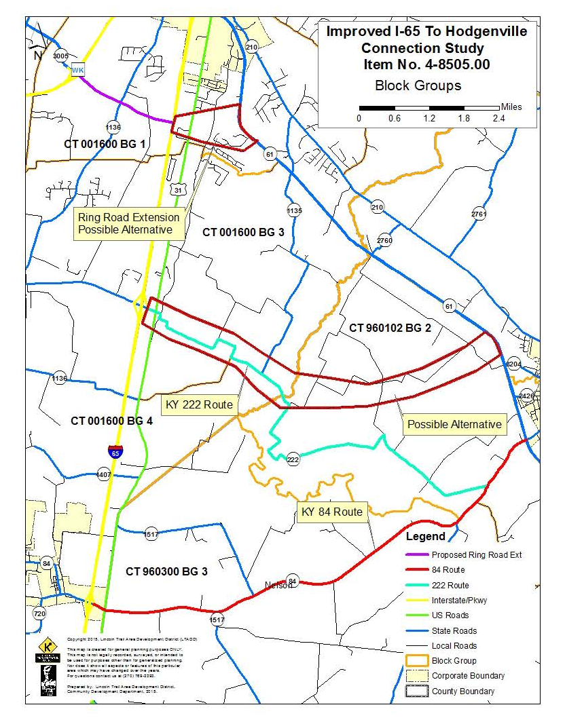
Environmental Analysis
What to Include?
Desk Top
Google Earth / GIS
Data Base Reviews
Field Work
Windshield Only
Site Visits

Slide 12
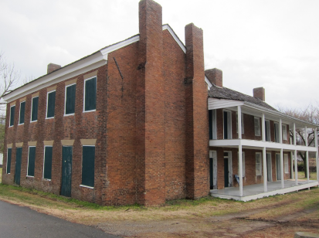
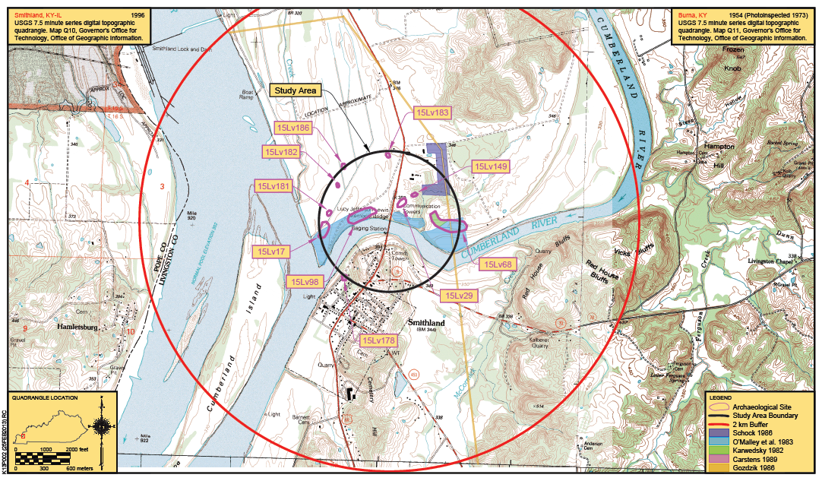
Environmental Analysis
Who Reviews / When?
District & Central Office
DEA / Subject Leads
Agency Input
Mail / Phone, etc.
Get Reviews Early
Determine in Scoping What Makes Sense

Slide 13
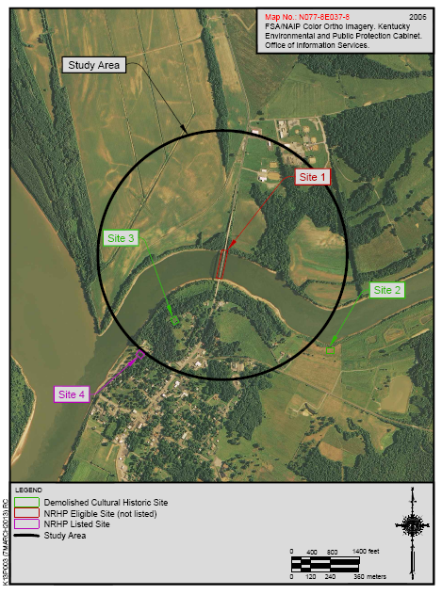
Environmental Analysis
More Will Be Done Later…..But
Find the “Unknowns” Now If You Can
Map / Quantify Them
Details Matter
Account for Risks

Slide 14
Capital Costs
What to Include?
Design
Right-of-Way
Utilities
Construction
Who Provides What?
Typically in Current Year Dollars
Project type will determine level of detail

Slide 15
Capital Costs
How to Estimate?
Don’t Use Per Mile Costs for everything
Determine Typical Section(s)
Estimate earthwork if data is available
Estimate pavement costs
Estimate structure sizes and costs
Estimate other items (such as drainage) based on similar-type projects

Slide 16
Traffic / TDFM
How Important are Traffic Estimates / Forecasts?
Millions of dollars spent each year based on them (design / construction)
Need them to be as accurate as possible based on best set of assumptions
Level of effort depends on what is needed (i.e., are you using them for?)

Slide 17
Traffic / TDFM
Overview of Tools
Historic Traffic Counts
Classification Counts
Spreadsheets
Travel Demand Models
Microsimulation
Statewide Factors
Data / Surveys
Constrained / Unconstrained
Professional Judgment

Slide 18
Traffic / TDFM
What’s a Model?
Mathematical formulas / equations used to replicate ‘real world’ travel behaviors
Are they the Only Answer?
Not at all. They are simply one tool in the toolbox.

Slide 19
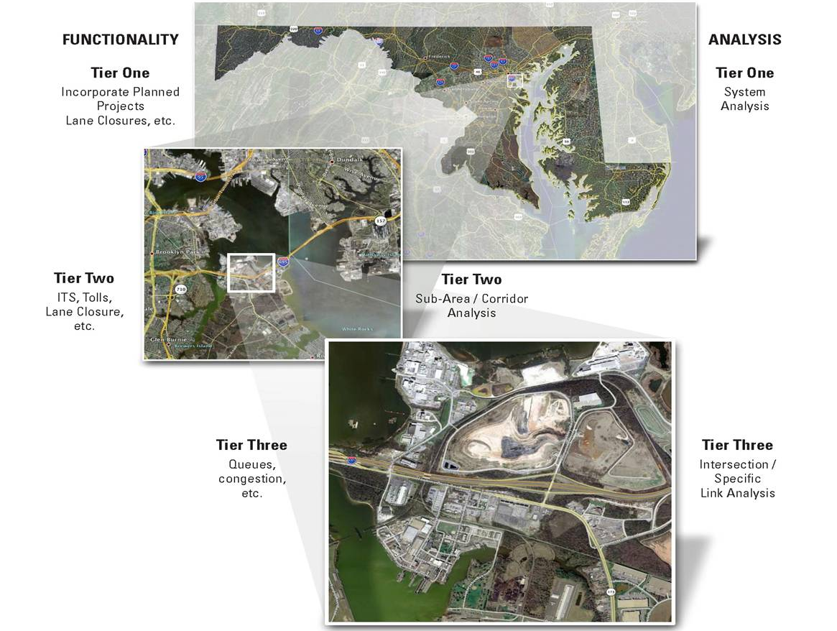
Traffic / TDFM
Macro
Meso
Micro

Slide 20
Traffic / TDFM
Calibration / Validation of Models
All models should be calibrated / validated to reasonable levels
Validation is important, but calibration of interim steps is critical
Consider unique travel patterns nearby which could impact your model

Slide 21
Traffic / TDFM
Potential Issues:
Lack of sufficient data
Does all the input data exist?
Underestimation of effort
How long will it take?
Too much information
What does the project team really need?
Communication:
Are all users being considered?

Slide 22
Traffic / TDFM
Suggestions:
Scoping: Proper scoping saves headaches later in the project
Discussion: Discussions of what tool(s) to use is very important (short term / long term)
Communication: Continual communication between project team and traffic staff

Slide 23
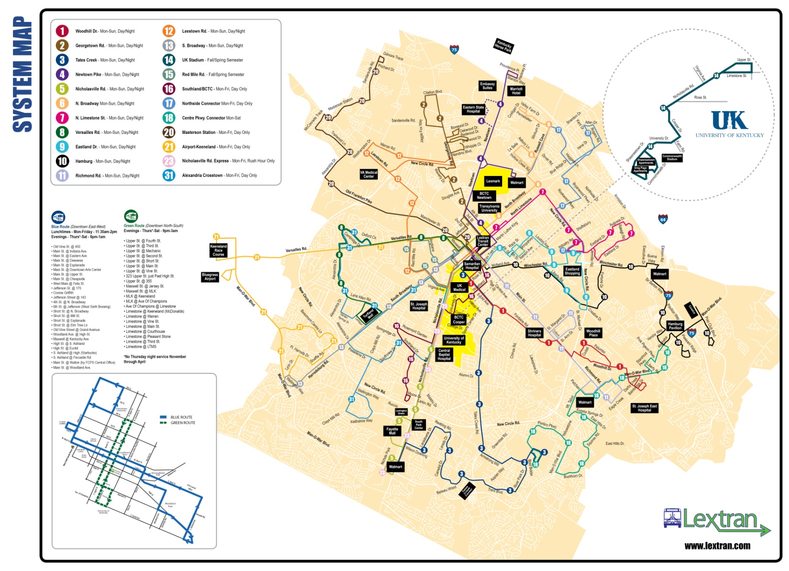
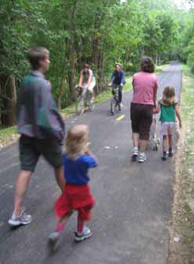
Multimodal Aspects
Don’t Forget About Other Modes
Pedestrians
Cyclists
Transit
Freight
How Do We
Include Operations?

Slide 24
Summary: The Keys to Success
Make “Good” Decisions Up Front
Involve All Disciplines
Lean Towards Doing More
Get Others Involved Early
Agencies
Local Officials
Stakeholders
Public
Other Divisions
Document Everything
Manage Expectations
Control Risks

